Slide 1
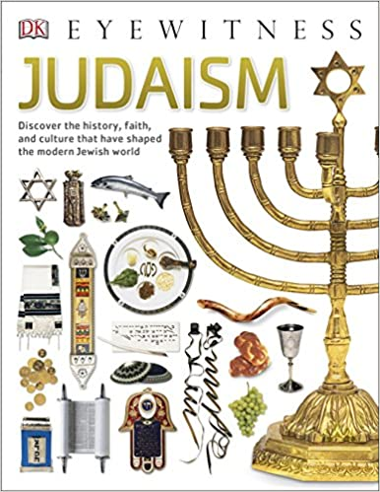
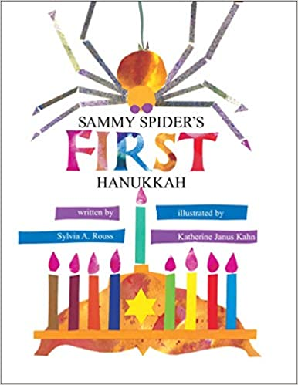
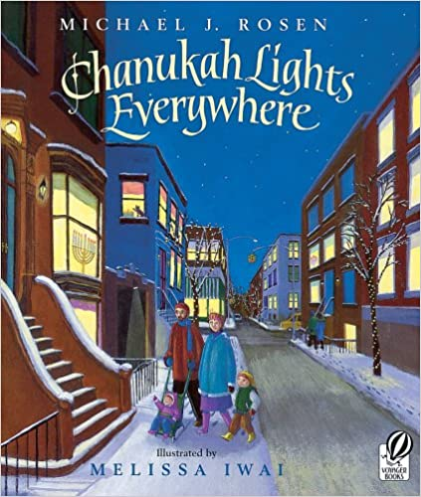
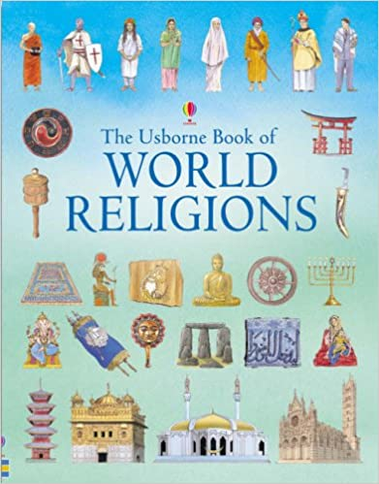
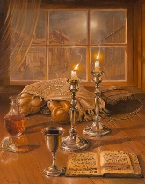
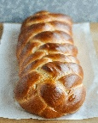
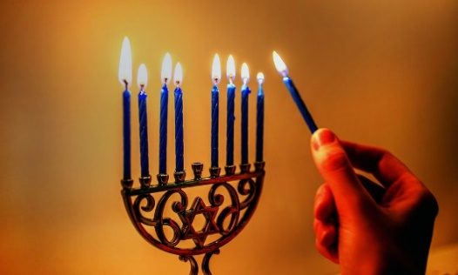
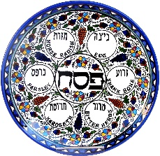
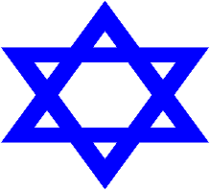
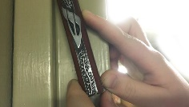
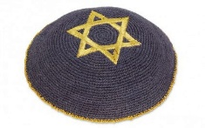
 |  | Judaism - KS1 Religious Education Knowledge Summary
Specific Vocabulary & definitions (meanings) |  |  | Facts to know by the end of the science sequence | Interesting Reading
Precious | Something of great value and meaning |  | Many people have objects in their home that are ‘precious’ to them and that these can be linked to religion
Star of David | The Jewish symbol, named after the Jewish King David |  | Objects such as a mezuzah, Seder plate, Star of David, kippah, chanukiah, challah bread may be found in a Jewish home
Torah | Jewish holy book |  | Jewish people believe in one God
Mezuzah | A piece of scroll contained in a decorated case. On it are written verses from the Torah |  | A mezuzah in the home reminds Jewish people about God and fulfils the commandment from the Torah ‘write the words of God on the gates and doorposts’ of your house.
Shema | A Jewish Prayer. This prayer is written on the Mezuzah |  | Jewish people celebrate Shabbat. It is a holy day in week when Jewish people rest and think about God.
Seder plate | A special plate containing foods eaten at Passover |  | To celebrate Shabbat. Jewish people light candles and say a prayer. They drink wine and eat challah. The family receive a blessing and sing songs in Hebrew, talk and tell stories.
Kippah | A cap made of cloth worn by Jewish males |  | Chanukah is a Jewish festival. It celebrates a miracle in which a days supply of oil allowed the menorah candle in the temple in Jerusalem to remain lit for 8 days | At the end of the topic I can:
Challah | A special Jewish bread eaten on Shabbat and at festivals |  |  | At the end of the topic I can:
Shabbat | Starting on Friday evening and finishing on Saturday evening, Shabbat it is a holy day each week where many Jewish people rest and really think about God |  |  | Talk about how the mezuzah in the home reminds Jewish people about God
 |  |  |  | Ask good questions about how Jewish artefacts are used and their meaning
Chanukah/ Hanukkah | An 8 day Jewish celebration also called the ‘Festivals of Lights’ |  |  | Talk about how Shabbat is a special day of the week for Jewish people
Chanukiah/ Hannukiah | A 9 branched candelabra lit during the festival of Chanukah. It represents the miracle of the oils burning for 8 days instead of 1. |  |  | Give some examples of what Jewish people might do to celebrate Shabbat
 |  |  |  | Re-tell a story that shows what Jewish people at the festivals of Chanukah might think about God
Art by
Alex Levin ‘Shabbat Shalom’

